Slide 1
FBI API Data Analysis
by Saumin and Olesia

Slide 2
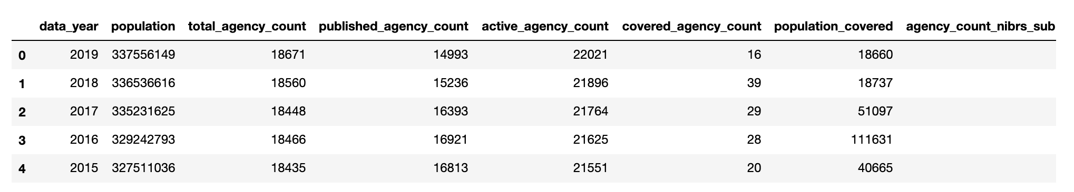
Major Terms Used in Dataset
NIBRS: National Incident-Based Reporting System
LEOKA: Law Enforcement Officers Killed and Assaulted

Slide 3
Hypothesis 1:
Compared to last 2 decades of the 20th century (1980-2000) the count of population covered by the FBI(NIBRS) increased by 20% in the first 2 decades of the 21st century (2000-2019)

Slide 4
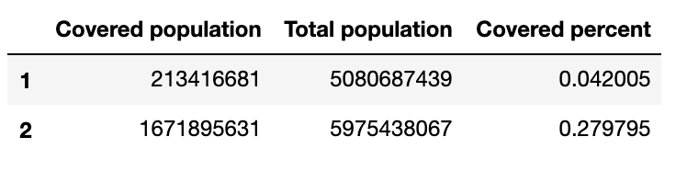
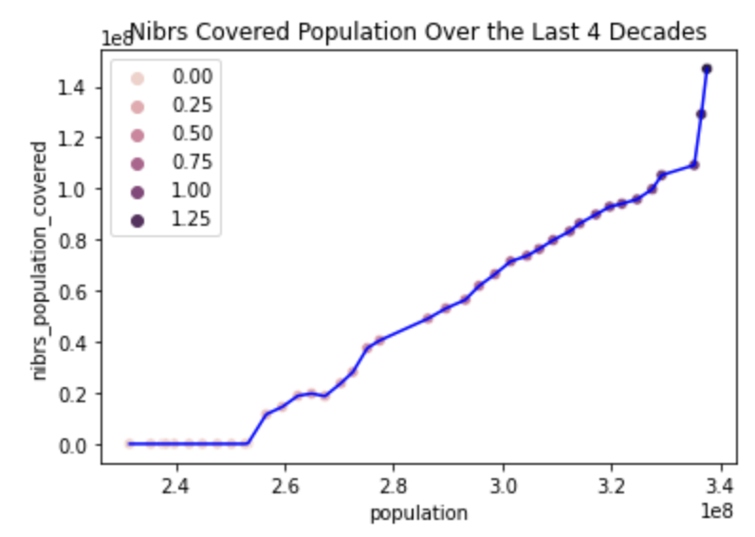
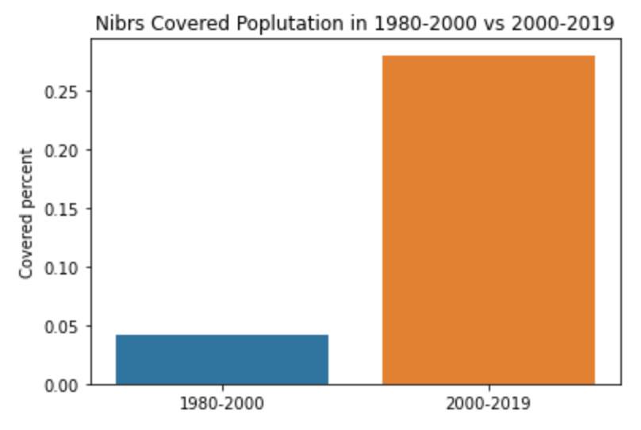
Hypothesis 1: Analysis
The population covered by the NIBRS (National Incident-Based Reporting System) increased by 566.099% in the last 2 decades (2000-2019) compared to the previous 2 decades (1980-2000).
Up until the population reached 250 million, the nibrs (National Incident-Based Reporting System) coverage was 0, and from that point it started to steadily grow until the present days. During the last few years it grew very quickly.

Slide 5
Hypothesis 2:
Compared to the previous 5 years (2010 - 2014), the percentage of law enforcement officers who got killed or assaulted (LEOKA) increased in the last 5 years (2015-2019) due to the increased amount of the illegal weapons

Slide 6
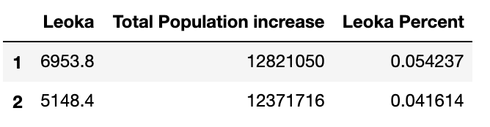
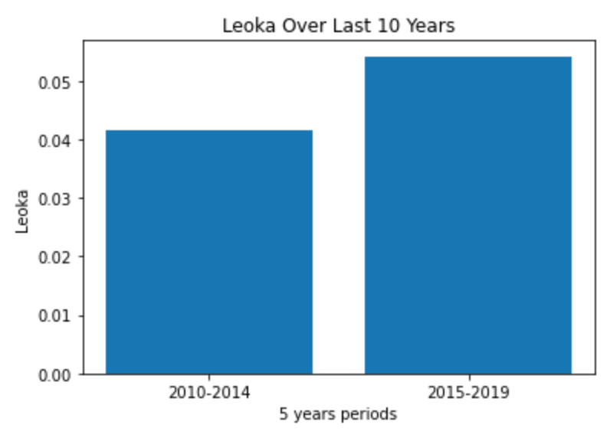
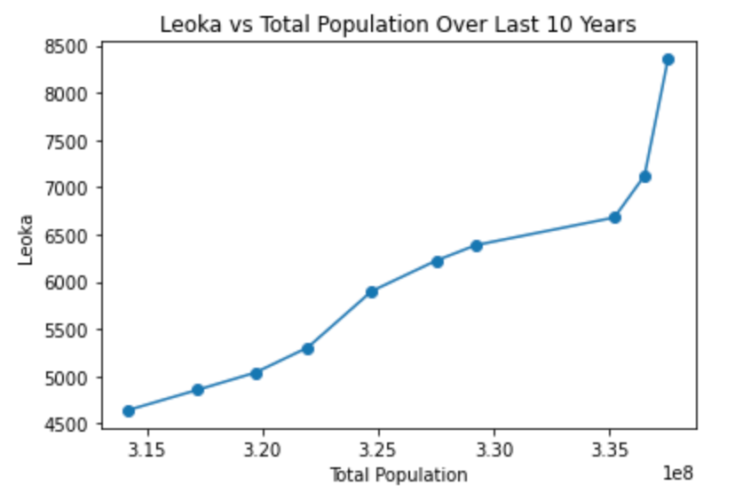
Hypothesis 2: Analysis
There was a 30.33% increase in LEOKA (Law Enforcement Officers Killed and Assaulted) cases per population in the last five years (2015-2019) compared to the previous 5 years (2010-2014)
The scatterplot above displays the increase of LEOKA cases over the period of last 10 years.

